Slide 1
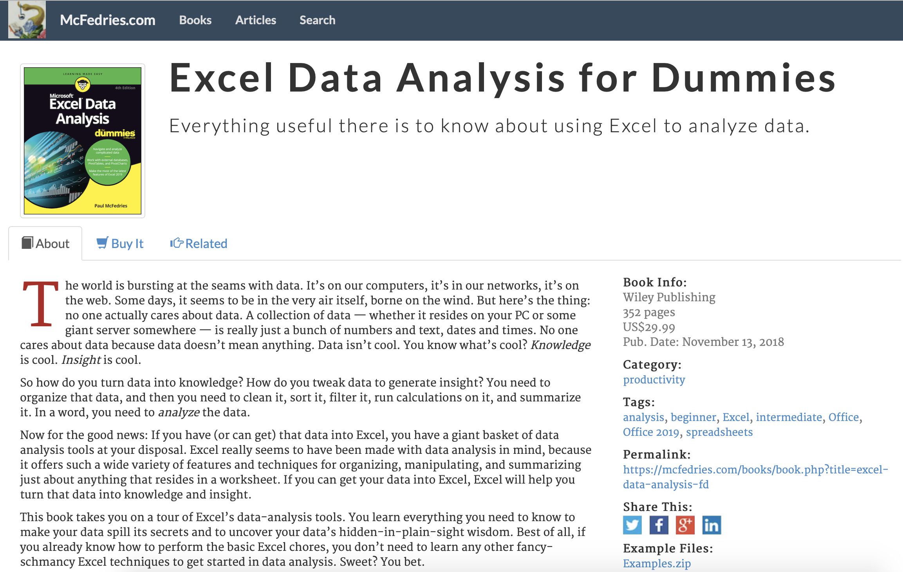
Excel Data Analysis for dummies
Studying Note
https://www.mcfedries.com/books/book.php?title=excel-data-analysis-fd
Click here to download the practice data

Slide 2
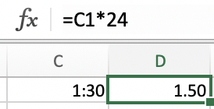
Shortcut key
Control + shift + arrow
Time to decimal hour: Time*24
Function
= SUMIF(A1:A10,”User”,B1:B10)
= IF(logical_test, [value_if_true], [value_if_false])
= IF(A1<10, “low”, IF(A1<20, “middle”, “high”))
= VLOOKUP(lookup_value, table_array, col_index_num, False/True) 精确/模糊
= HLOOKUP(lookup_value, table_array, row_index_num, False/True) 精确/模糊
= RANDBETWEEN(1,4)
= Offset([reference],[rows],[cols],[height],[width])

Slide 3
Chapter 1 Learning Basic Data-analysis Techniques
Analyzing Data with Conditional Formatting
Highlighting cells that meet some criteria
Showing pesky duplicate values
Highlighting the top or bottom values in a range
Analyzing cell values with data bars
Analyzing cell values with color scales
Analyzing cell values with icon sets
Summarizing Data with Subtotals
Grouping Related Data
Consolidating Data from Multiple Worksheets (Combining multiple worksheets into a summary report.)
Consolidating by position: Worksheets we’re consolidating have an identical layout.
Consolidating by category: Worksheets we’re consolidating have different layouts but common labels.

Slide 4
Chapter 2 Working with Data-Analysis Tools
Analyzing Data with Goal Seek
Goal seek: trying dozens of possibilities to get closer and closer to a solution.
Future value calculation: calculates the future value of an investment given an interest rate, term, and regular deposit.
Working with Data Tables
Data table is special range that excel uses to calculate multiple solutions to a formula.
One-input data table: vary only one of the formula’s input cells.
Two-input data table: vary two formula inputs at the same time.
Skipping data tables when calculating workbooks: Formulas ➮ Calculation Options ➮ Automatic Except for Data Tables
Analyzing Data with Scenarios
Scenario: coherent sets of input values (three or more input values at a time)
Optimizing Data with Solver
When should use solver? Find the optimized parameter for your equation.
break-even analysis, maximized profits, minimize cost, etc.
Save a solver solution as a scenario
Advantages of solver
Solver enables you to specify multiple adjustable cells.
Solver enables you to set up constraints on the adjustable cells.
Solver seeks not only a desired results but also the optimal one.
Solver can generate multiple solutions.

Slide 5
Chapter 3 Introducing Excel Tables
Range ⬄ Table
Choose Range ➮ Insert ➮ Tables (or Command + T)
Choose any cell of Table ➮ Data ➮ Table Tool ➮ Convert to Range
Advanced Filters
Chapter 4 Grabbing Data from External Sources
Import data from
Word table
Text file
Web page
XML file
External Databases
Notes:
XML file: Cannot realize on Mac excel version

Slide 6
Chapter 5 Cleaning Data
Data: disorganized, inconsistent, inaccurate, etc.
CLEAN([text]): remove nonprintable characters
TRIM([text]): remove extra spaces, line feeds, carriage returns and tabs from a string
CONCAT([text], [text]…): join two or more chunks of text into a single string
TEXTJOIN([delimiter],[ignore_empty],[text1]…): combine two or more string into s single string with the specified delimiter
EXACT([text], [text]): compare two strings
LEN([text]): count the number of characters in a string
FIND([find_text],[within_text],[start_num]): find the starting character position of one string
SEARCH([find_text],[within_text],[start_num]): return the starting position of a specified string within a string
LEFT([text],[num_chars]): return a specified number of characters from the left end of a string
RIGHT([text],[num_chars]): return a specified number of characters from the end of a string
MID([text],[start_num],[num_chars]): return a chunk of text from inside of a string
LOWER([text]): return all-lowercase version of a string
UPPER([text]): return all-uppercase version of a string
PROPER([text]): capitalize the first letter of every word in a string
NUMBERVALUE([text],[decimal_separator],[group_separator]): convert digits formatted as a string to a true numeric value
VALUE([text]): converts a string that looks like a numeric value to an actual number
REPLACE ([old_text],[start_num],[num_chars],[new_text]): replace a portion of a string with new text
SUBSTITUTE([text],[old_text],[new_text],[instance_num]): replace occurrences of text in a string

Slide 7
Chapter 6 Analyzing Table Data with Function
Database functions: special set functions especially for the statistical analysis
DGET([database],[field],[criteria])
DSUM([database],[field],[criteria])
DCOUNT([database],[field],[criteria])
DAVERAGE([database],[field],[criteria])
DMAX/DMIN([database],[field],[criteria])
DPRODUCT([database],[field],[criteria])
DSTDEV([database],[field],[criteria])
DVAR([database],[field],[criteria])
returns the sum/count/average…. of values from a set of records that match criteria.
database : The range of cells that make up the table you want to work with, it includes headers.
field : A reference to the table column on which you want to perform the operation.
criteria : Criteria range including headers.

Slide 8
Chapter 7 Creating and Using PivotTables
Pivot table can take records and summarize them into a compact, comprehensible report.
PivotTable: performing three operations
Grouping the data into categories;
Summarizing the data using calculations;
The default summary calculation for Text values is Count.
Filtering the data to show just the records you want to work with
Grouping PivotTable Values: reducing the number of items
Grouping numeric values
Grouping date and time values
Grouping text values
Filtering PivotTable Values
Report filter: applies to the entire PivotTable
Label filter & Date filter & Value filter: applies only to the filter field
Value filter: restrict the values that shown in the value area.
Slicer
Independent of any PivotTable. It can be used to filter multiple PivotTables.
Connect slicer with PivotTable: Right click ➮ Report Connections ➮ Choose icon of PivotTable ➮ OK

Slide 9
Chapter 8 Performing PivotTable Calculations
Summary Calculations apply over an entire field
Average, Max, Min, Product, Sum
Count: the total number of cells in the source field
Count numbers: the total number of numeric values in the source field
StdDev: the standard deviation of a population sample
StdDevp: the standard deviation when the values in the data field represent the entire population
Var: the variance of a population sample
Varp: the variance when the values in the data field represent the entire population
Summary Calculations comparing item with another
Base field: which field in your PivotTable to use as the comparison field
Base item: which item within that field to use as the basis for all the comparison
Difference Summary calculation: comparing one item with another
Difference From: comparing one numeric item with another and returns the difference between them
%Difference From: comparing one numeric item with another and returns the percentage difference between them
Percentage summary calculation: comparing two or more items as a percentage
% of: returns the percentage of each value with respect to a selected base item
% of Row Total : returns the percentage that each value in a row represents of the total value of the row
% of Column Total : returns the percentage that each value in a column represents of the total value of the column
% of Grand Total : returns the percentage that each value in a row represents of the PivotTable grand total
% of Parent Row Total : returns the percentage that each value in an inner row represents with respect to the total of the parent item in the outer row
% of Parent Column Total : returns the percentage that each value in an inner column represents with respect to the total of the parent item in the outer column
% of Parent Total : returns the percentage of each value with respect to a selected base field in the outer row or column

Slide 10
Chapter 8 Performing PivotTable Calculations
Running total summary calculation: show the cumulative sum of the values that appear in a given set of data.
Most running totals accumulate over a period of time.
Running Total applies to not just the Sum calculation but also related calculations, such as Count and Average.
Running total in
% running total in
Index summary calculation:
determining the relative importance of the results
Index calculation determines the weighted average of each cell in the PivotTable results, where the average taking into account the relative importance of each value.
(Cell value) * (Grand Total) / (Row Total) * (Column Total)
Custom Calculations
Inserting a Custom Calculated Field
Be careful the Grand Total value is often inaccurate
Inserting a Custom Calculated Item
Custom Calculation Limitations
You can’t use a cell reference, range address, or range name as an operand in a custom calculation formula.
You can’t use any worksheet functions that requires a cell reference, range or defined name in a custom calculation formula.
You can’t use the PivotTable’s subtotals, row totals, columns totals, or grand total as an operand in a custom calculation formula.
PivotTable Subtotals
Turning off subtotals for a field
Displaying multiple subtotals for a field

Slide 11
Chapter 9 Building PivotCharts
PivotChart
Chart Categories (X-axis): It automatically groups large amounts of data.
Chart Data Series: One can break down the data in terms of a second field.
Chart Values (Y-axis): Equivalent of a value field in a PivotTable.
Dynamic PivotChart: One can reconfigure as needed
Filtering: Used to filter the chart results.
Limitations of PivotChart
Three chart types (Bubble, XY Scatter, Stock) can’t apply to a PivotChart.
Adding , removing and pivoting fields have to use the underlying PivotTable.
Creating a PivotChart
Creating a PivotChart from a PivotTable: select any cell in the PivotTable ➮ Press F11
Embedding a PivotChart on a PivotTable’s worksheet
Creating a PivotChart from an Excel table
Working with PivotChart
Moving a PivotChart to another sheet
Filtering a PivotChart: Use Slicer for mac version
Changing the PivotChart type
Adding data labels to your PivotChart
Working with PivotChart
Sorting the PivotChart
Adding PivotChart titles
Moving the PivotChart legend
Displaying a data table with the PivotChart
Notes:
Pivotchart is a graphical representation of the PivotTable. It enables you visualize the PivotTable results.
Pivotchart goes far beyond a regular chart, such as filtering the results.

Slide 12
Chapter 10 Tracking Trends and Making Forecasts
Plotting Trend Line and Calculating Forecasted Values
R² (coefficient of determination):
The square of the correlation.
How well the trend line fits the data. (R² < 0.7 means not very good fit for the data)
The percentage of the response variable variation that is explained by model
Every time adding a predictor to a model, the R² increase. It never decrease.
Linear Trend Line y = mx + b
Trend Function: TREND(known_ys, know_xs, new_xs, const)
Get regression value: Linest(known_ys, know_xs, const, stats)
Return (m, b)
const: determine the y-intercept
False places it at 0
True (the default) calculates the y-intercept
stats:
False enter the function as a 1×2 array
True enter the function as a 5×2 array
Exponential Trend Line y = b e ^{mx} = b (e^{m})^{x}
Forecast: Growth(known_ys, know_xs, new_xs, const)
Get regression value: Logest(known_ys, know_xs, const, stats)
Return (e^{m}, b)
Logarithmic Trend Line y = m * ln (x) + b
Get regression value: Linest(known_ys, LN(know_xs), const, stats)
Return (m, b)
Power Trend Line y = m * x^{b}
Get regression value: Linest(LN(known_ys), LN(know_xs), const, stats)
Return (b, C = b*lnm)
m = exp(C/b)
Polynomial Trend Line y = m_{n} * x^{n} + ….. m₁ * x¹ + b
Get regression value: Linest(known_ys, know_xs ^ {1,2,…n}, const, stats)
Return (m1,m2…., b)
Notes:
Trend analysis:
Charting the overall trend of a set of values
Calculating values that show how data is trending
Charting historical data into future periods
Calculating future values given some historical data
Charting exponential, logarithmic, power, and polynomial trends.
Best-fit trend line gives you a sense of the overall trend of a set of data.
R2 below 0.7 mean that the trend line isn’t a very good fit for the darta.

Slide 13
Chapter 11 Analyzing Data with Statistics
Counting Things
COUNT: return how many numeric values are in the range
COUNTA: return how many nonempty values are in the range
COUNTBLANK: return how many empty values are in the range
COUNTIF: return how many cells match criteria
COUNTIFS: return how many cells match multiple criteria
PERMUT: return the number of ways that a subset of that data can be grouped
PERMUTATIONA: allow repetitions in the subset
COMBIN: counts the number of combinations possible when selecting unique subsets from a data set
COMBINA: allow repeat
Averaging Things
AVERAGE: calculate the average of the values
AVERAGEIF: calculate the average of the values which match the criteria
AVERAGEIFS: calculate the average of the values which match multiple criteria
MEDIAN: Midpoint in a series of numbers
MODE: the common value in a list of values
Finding the Rank
RANK.EQ: determine an item’s rank relative to other items in a list
RANK.AVG: (average the rank if two or more numbers have the same rank)
PERCENTRANK.INC: determine the rank of a value as a percentage of all the values in the set
PERCENTRANK.EXC: (excluded the ranks of 0 and 100)
The Nth Largest / Smallest value
LARGE: return the nth highest value in a list
SMALL: return the nth smallest value in a list
Creating a Grouped Frequency Distribution
FREQUENCY: return the number of occurrences in each group
Variance
VAR.S: the data represents a sample of a large population
VAR.P: the data represents the entire population
Standard Deviation
STDEV.S: the data represents a sample of a large population
STDEV.P: the data represents the entire population
Correlation
CORREL : return the correlation coefficient (-1,1)
Notes:
Learning the countless way to count things in Excel
Calculating the mean, median, mode and other average
Figuring out a values’ rank in relation to the rest of the data
Grouping your data into a frequency distribution
Messing around with statistical powerhouses such as standard deviation and correlation.

Slide 14
Chapter 12 Analyzing Data with Descriptive Statistics
https://www.excel-easy.com/data-analysis/analysis-toolpak.html
Generating Descriptive Statistics
Calculating a Moving Average
Moving average smooth a data series by averaging the series values over a specified number of preceding period.
A moving average weighs recent values equally and ignore older values, thereby enabling you to spot trends.
Determining Rank and Percentile
Percentile: percentage of items in the sample that are at the same level or a lower lever than a given value.
Point: The location of the data value within the specified input range.
Generating Random Numbers
Generate random values using various distributions
Uniform, Normal, Bernouli, Binomial, Possion, Patterned, Discrete
Excel Function
Rand: generate random numbers between 0 and 1
RandBetween: generate random numbers between two specified values.
Creating a Frequency Distribution
Frequency distribution organizes the data into numeric ranges (bins) and tells you the number of observations that fall within each bin.
Histogram: is a chart of a frequency distribution
Notes:
Generating oodles of descriptive statistics 大量的描述性统计
Calculating moving averages, ranks, and percentiles
Generating random numbers, for some reason
Creating frequency distributions and hisograms

Slide 15
Chapter 13 Analyzing Data with Inferential Statistics
Sampling Data
Periodic: Extracts every nth item from the data set
Random: Extracts items randomly from the data set
Using the t-Test Tools
T-test: Paired Two Sample for Means
T-test: Two Sample Assuming Equal Variance
T-test: Two Sample Assuming Unequal Variance
H₀: μ₁ - μ₂ = 0
two-tail test:
t Stat < -t Critical two-tail or t Stat > t Critical two-tail
➮ reject H₀
Performing a z-Test
Know the variance or standard deviation of the population
Determining the Regression
Regression Statistics:
Multiple R,
R Square,
Adjusted R Square,
Standard Error
ANOVA:
Significance F: check if results are reliable (statistically significant).
Significance F < 0.05: Statistically significant.
Significance F ≥ 0.05: Delete a variable with a high P-value (≥ 0.05) and rerun the regression until Significance F drops below 0.05.
ANOVA | df | SS | MS | F | Significance F
Regression
Residual
Notes:
Periodic: Extracts every nth item from the data set
Random: Extracts items randomly from the data set

Slide 16
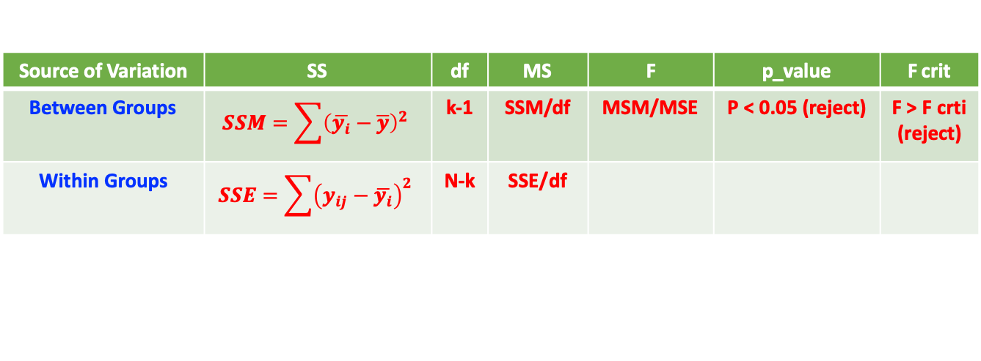
Chapter 13 Analyzing Data with Inferential Statistics
Calculating the Correlation
The correlation coefficient [-1,1] tells you how strongly two variables are related to each other.
Calculating the Covariance
Using the Anova Tools
Anova: Single Factor
Anova: Two-Factor With Replication
Anova: Two-Factor Without Replication
Comparing sets of data by looking at the variance of values in each set. H₀: μ₁ = μ₂ = μ₃ if means of several populations are all equal.
F > F crit, reject H0 ➮ The means of those populations are not all equal.
F-test two-sample for variance
Comparing variance from two population
H₀: σ₁² = σ₂² two samples come from two independent populations having the equal variances.
Important: be sure that the variance of Variable 1 is higher than the variance of Variable 2. If not, swap your data.
F = Variance of Variable 1 / Variance of Variable 2
F value > F Critical value, reject H0 ➮ the variances of two samples are not equal.
Source of Variation | SS | df | MS | F | p_value | F crit
Between Groups | $$SSM=\sum{{\left(\overline{y_{i}}−\overline{y}\right)}^{2}}$$ | k-1 | SSM/df | MSM/MSE | P < 0.05 (reject) | F > F crti (reject)
Within Groups | $$SSE=\sum{{\left(y_{ij}−\overline{y_{i}}\right)}^{2}}$$ | N-k | SSE/df
Notes:
H0: two samples come from two independent populations having the equal variances.

Slide 17
Chapter 14 Ten thing You ought to know about Statistics
Descriptive Statistics Are Straightforward
Average Aren’t so simple Sometimes
What type of average is used?
Standard Deviations Describe Dispersion
Standard deviation describes how values in a data set are dispersed around the mean.
An Observation is an Observation
A Sample is a subset of values
A sample is a collection of observations from a population
Inferential Statistics are cool but complicated
Probability Distribution aren’t confusing
Uniform distribution:
Normal distribution: Gaussian distribution
Norm.dist([x],[mean],[standard_dev],[cumulative])
Parameters aren’t so complicated
Skewness and Kurtosis describe a probability Distributions’ shape
Skewness quantifiers the lack of symmetry in a probability distribution. Skewness = 0 for perfect symmetrical distribution.
Kurtosis quantifiers the heaviness of the tails in a distribution. Kurtosis = 0 for normal distribution.
Confidence intervals seem complicated at first, but are useful
Notes:
H0: two samples come from two independent populations having the equal variances.

Slide 18
Chapter 15 Ten ways to analyze Financial Data
Calculating Future Value
FV(rate, nper, pmt [, pv][,type])
Rate: the interest rate of investment
nper: the term of the investment
pmt: amount of each regular deposit (negative value)
pv: initial investment (negative value)
type: when deposits are due (0 for end of period, 1 for beginning of period)
Calculating Present Value
PV(rate, nper, pmt [, fv][,type])
Present value is used to recognize the time value of money.

Slide 19
Chapter 15 Ten ways to analyze Financial Data
Determining Loan Payments
PMT(rate, nper, pmt [, fv][,type])
Calculate the regular payment you must make to repay the loan.
PMT(0.03/12, 25*12, 20000) : Monthly payment on a 3%, 25-years $20000 mortgage.
Calculating a Loan Payment’s Principal and Interest
PPMT(rate, per, nper,pv [, fv][,type])
IPMT(rate, per, nper,pv [, fv][,type])
Know the total amount for a regular loan payment, but breaking down a loan payment into its principal and interest.
per: the number of the payment period
PPMT(0.03/12, 1, 25*12, 20000) : The first monthly payment on a 3%, 25-years $20000 mortgage.
Calculating Cumulative Loan Principal and Interest
CUMPRINC(rate, nper, pv, start_period, end_period, [,type])
CUMIRINC(rate, nper, pv, start_period, end_period, [,type])
CUMPRINC(0.03/12, 25*12, 20000,1,12,0): the cumulative principal 本金 or interest in the first year of a loan

Slide 20
Chapter 15 Ten ways to analyze Financial Data
Finding the Required Interest Rate
Rate(nper, pmt, pv[, fv] [,type][,guess])
fv: the future value of the loan ( the end-of-loan balloon payment)
If you know how much you want to borrow, how long a term you want, and what payments you can afford, you can calculate what interest rate will satisfy these parameters.
Nper(rate, pmt, pv[, fv] [,type])
If you know the principal, the interest rate, and the payment, you can calculate the length of the loan
Determining the Internal Rate of Return
IRR(values [,guess])
Internal rate of return is related to the net present value, which is the sum of a series of net cash flows, each of which has been discounted to the present using a fixed discount rate.
The internal rate of return can be defined as the discount rate required to get a net present value of $0.
IRR(B3:G3,0.11): return the internal rate of return using an initial guess of 0.11 for given cash flows in range B3:G3

Slide 21
Chapter 15 Ten ways to analyze Financial Data
Calculating Straight-Line Depreciation
SLN(cost, salvage, life)
cost: the initial cost of the asset
salvage: the salvage value of the asset
life: the life of the asset in period
Returning the Fixed-Declining Balance Depreciation 固定下降余额折旧
DB(cost, salvage, life, period[, month])
Some assets produce more in earlier years than in later years. For those assets, accountants use accelerated methods of depreciation, which take more depreciation in the earlier years than in the later years.
Determining the Double-Declining Balance Depreciation
DDB(cost, salvage, life, period[, factor])
Double-declining balance is an accelerated depreciation method that takes the rate you would apply by using straight-line depreciation, double it, and then applies the doubled rate to the carrying value of the asset.
DDB function does not depreciate the asset below the salvage value.

Slide 22
Chapter 16 Ten ways to Raise your PivotTable Game
Turn the PivotTable Fields Task Pane On and Off
Change the PivotTable Fields Task Pane Layout
Display the Details Behind PivotTable Data
Apply a PivotTable Style
Create a Custom PivotTable Style
Preserve PivotTable Formatting
Rename the PivotTable
Turn off Grand Totals
Reduce the Size of PivotTable Workbooks
Use a PivotTable Value in a Formula
Notes:
H0: two samples come from two independent populations having the equal variances.

Slide 23
Business Statistics and Analysis Specialization
Studying Note
https://www.coursera.org/specializations/business-statistics-analysis?
Rice University

Slide 24
Course 2 Basic Data Descriptors, Statistical Distributions, and Application to Business Decisions
Mode.sngl(range)
Quartile.inc(array, quart)
Stdev.P(range) or. Stdev.S(range)
Covariance.S(range1, range2)
Correl(range1, range2)

Slide 25
Course 2 Basic Data Descriptors, Statistical Distributions, and Application to Business Decisions
Normal(mean, std)
Norm.dist(x, mean, std, True)
Norm.inv(p, mean, std)
Binom.dist(x, n, p, False/True)
Poisson.dist(x, 𝜆, False/True)

Slide 26
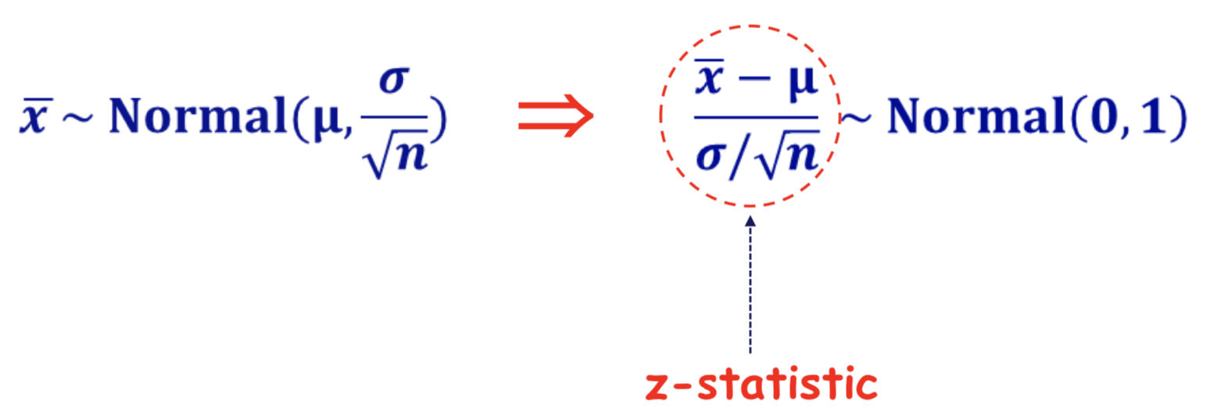
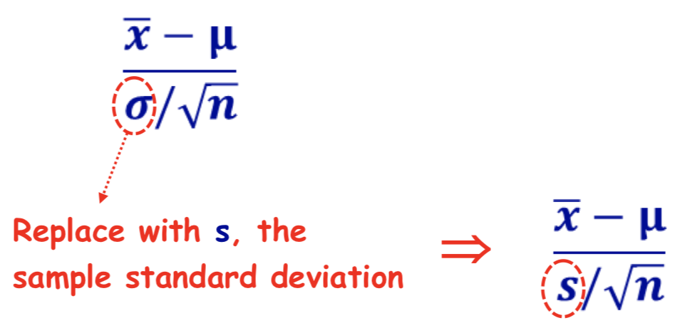
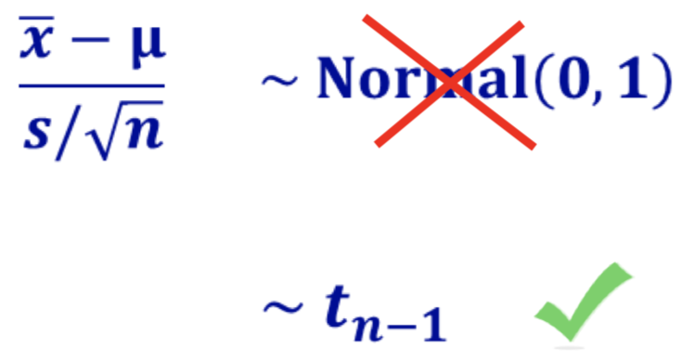
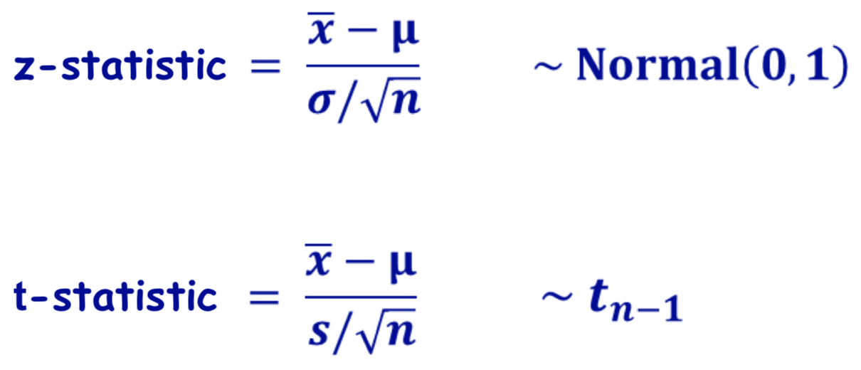
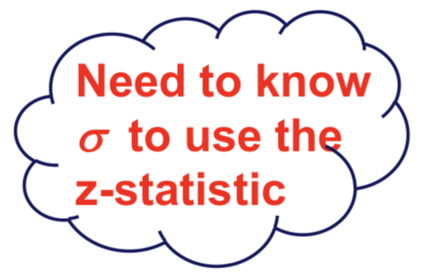
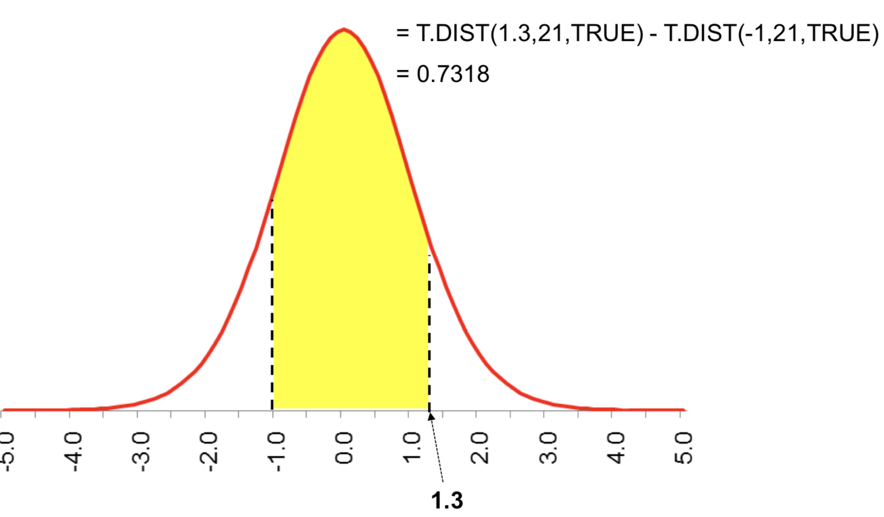
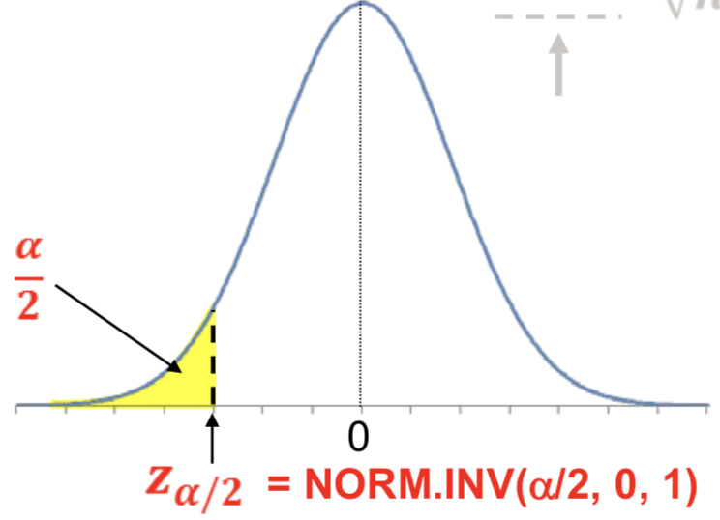
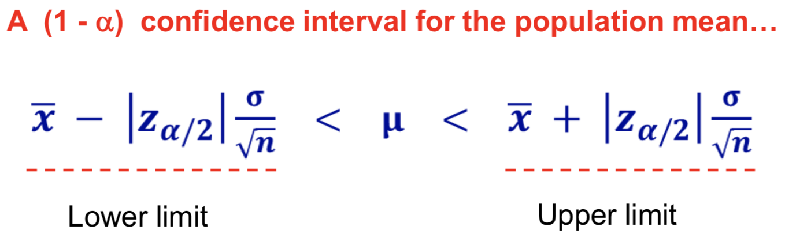
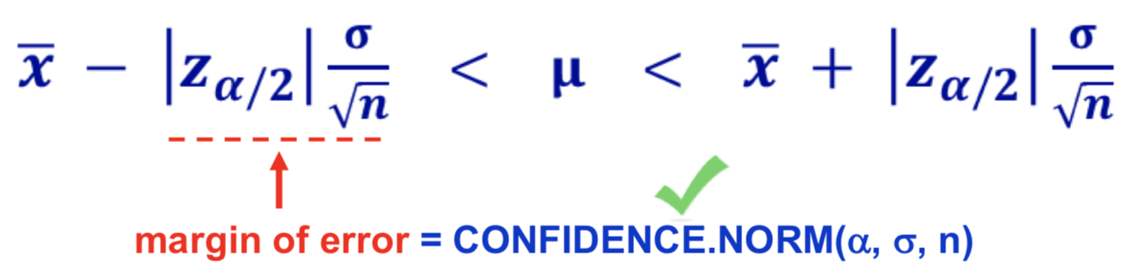
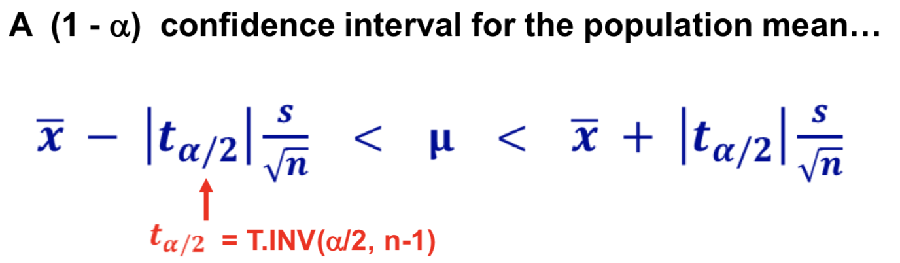
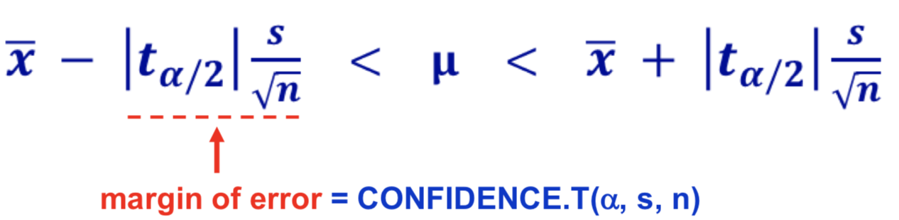
Course 3 Business Applications of Hypothesis Testing and Confidence Interval Estimation
t distribution
Probability = T.dist(x, df, True)
x = T.inv(p, df)
Confidence Interval
for the “Population” mean

Slide 27
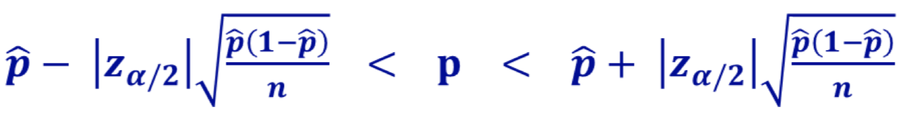
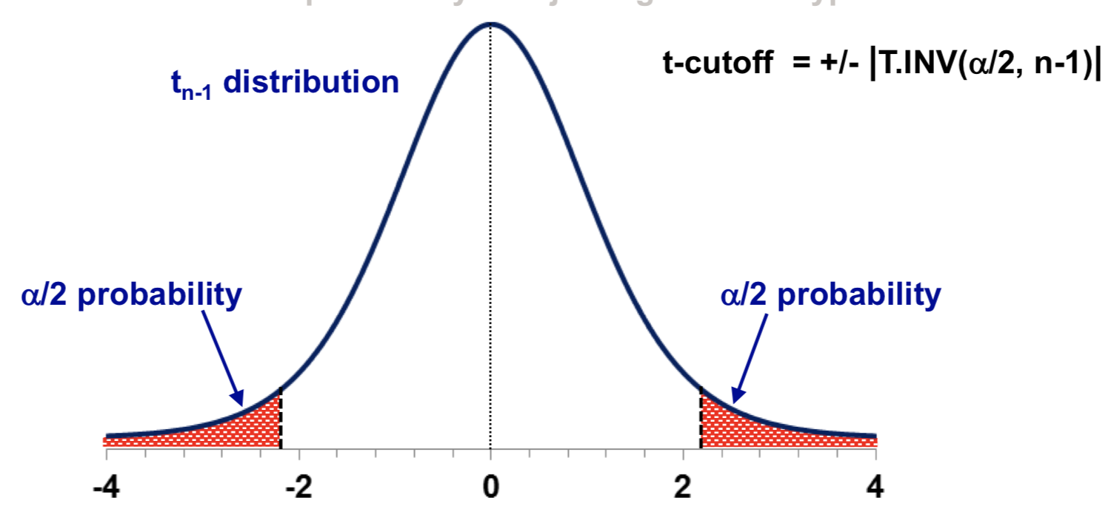
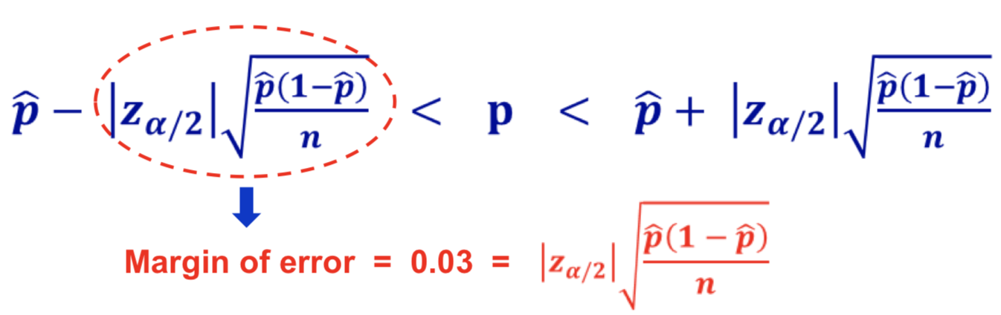
Course 3 Business Applications of Hypothesis Testing and Confidence Interval Estimation
Confidence Interval
for unknown population proportion
Hypothesis testing
Hypothesis Test is a scientific tool to aid your decision making
A scientific procedure of hypothesis testing takes into account size of the sample, variability in the sample and level of significance in the conclusion.
Sample size
Confidence interval for the “Population”
If p̂ is unknown when you want to calculate the sample size for a given margin of error in a population proportion confidence interval. We can use p̂=0.5 to estimate.
Formulate Hypothesis
Calculate the t-statistic
Cutoff values for the t-statistic
Check whether t-statistic falls in the rejection region

Slide 28
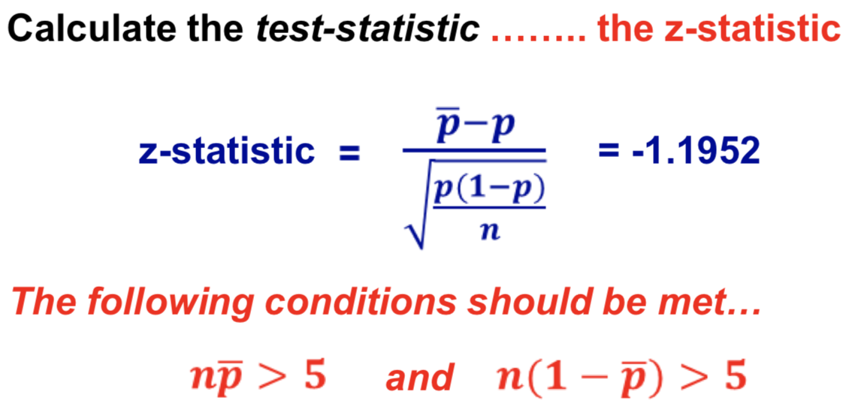
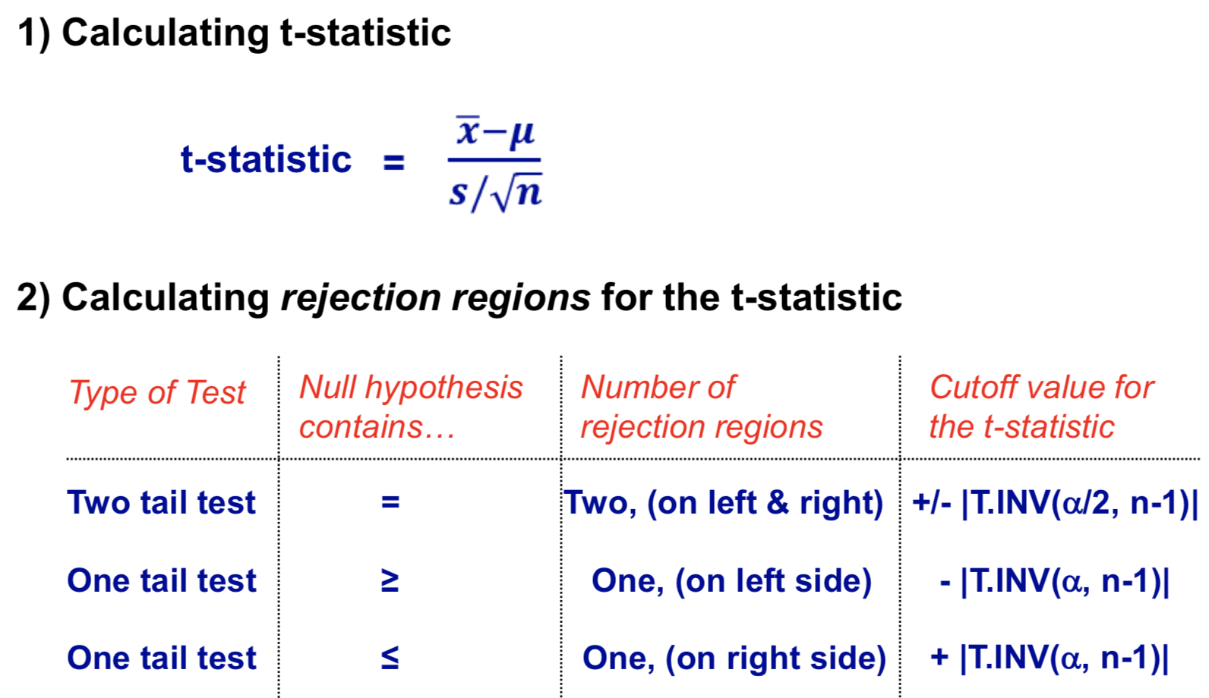
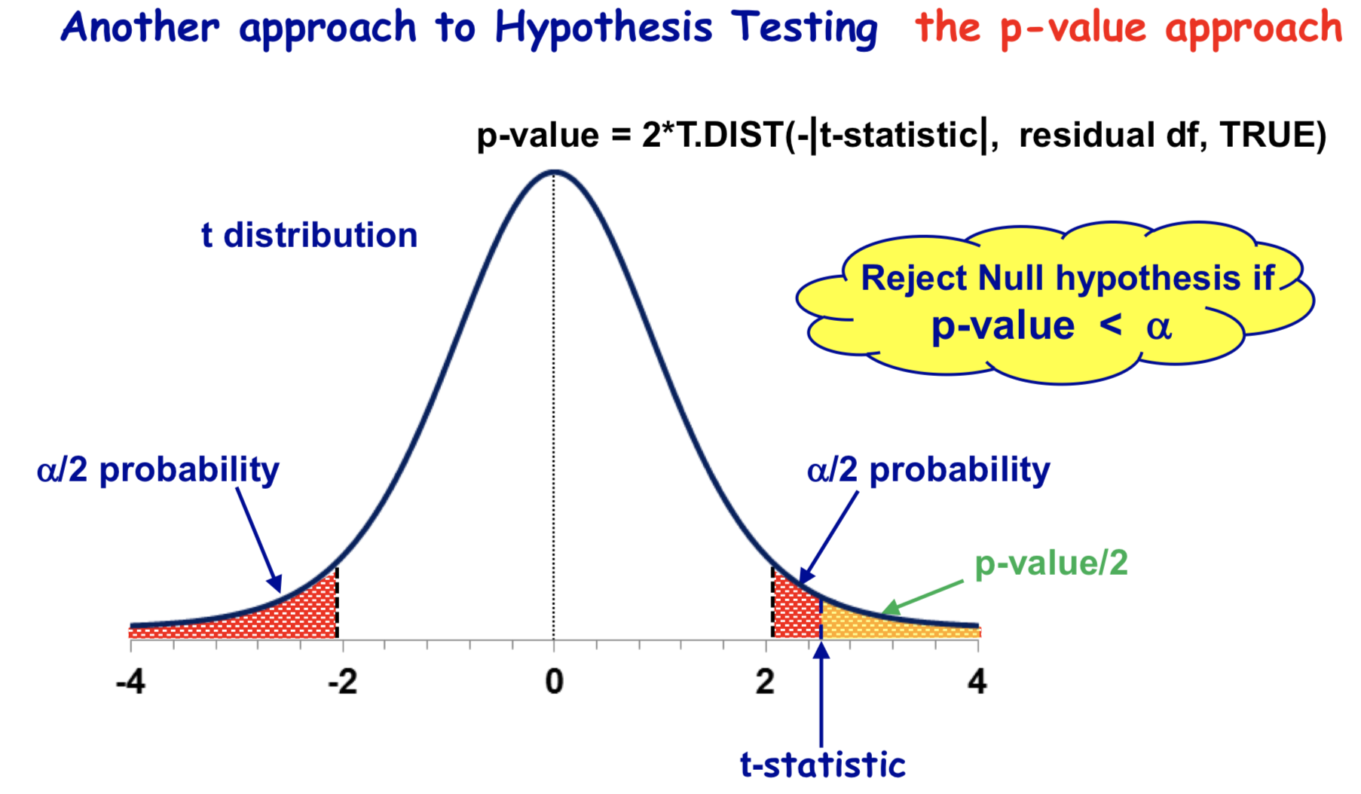
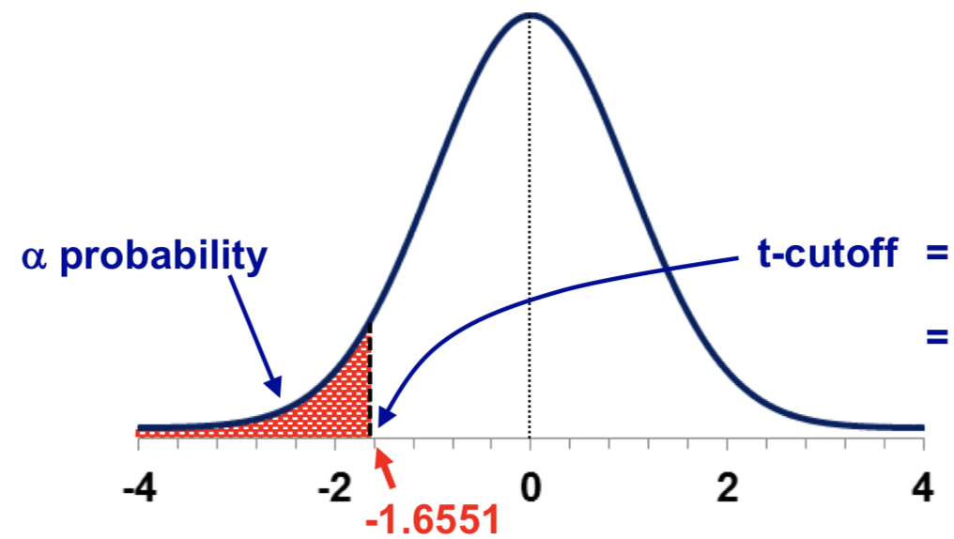
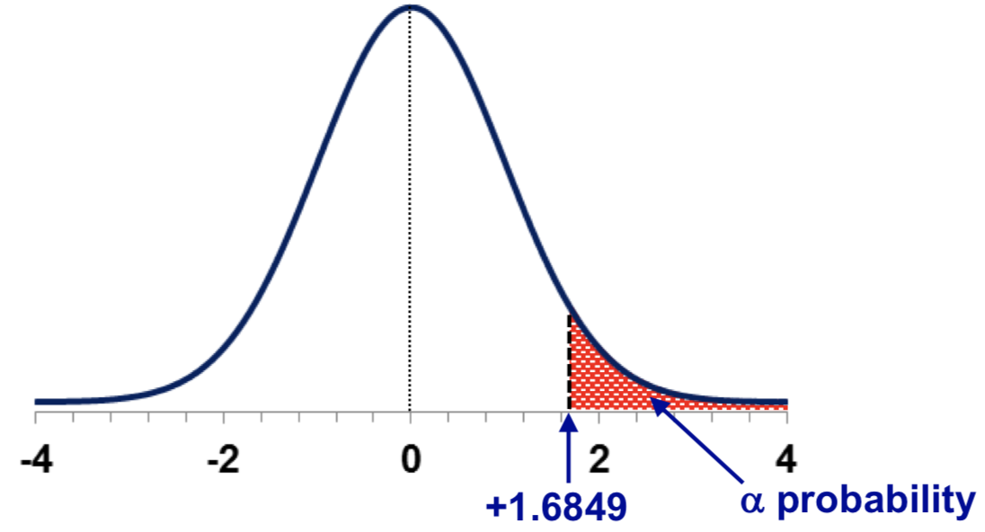
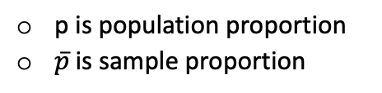
Course 3 Business Applications of Hypothesis Testing and Confidence Interval Estimation
Hypothesis testing
Null hypothesis should not have a strict inequality
Null hypothesis cannot have, ≄ > <
It can only have = ≥ ≤
If the null hypothesis is a strict inequality, then you need to flip the null hypothesis and alterative hypothesis.
p is population proportion
$\overline{p}$ is sample proportion
Notes:
Hypothesis Test is a scientific tool to aid your decision making
One tail Hypothesis
There is one rejection region which has size 𝜶
When the rejection region is on the left and the t-statistic is less than the cut-off value
When the rejection region is on the right and the t-statistic is greater than the cut-off value

Slide 29

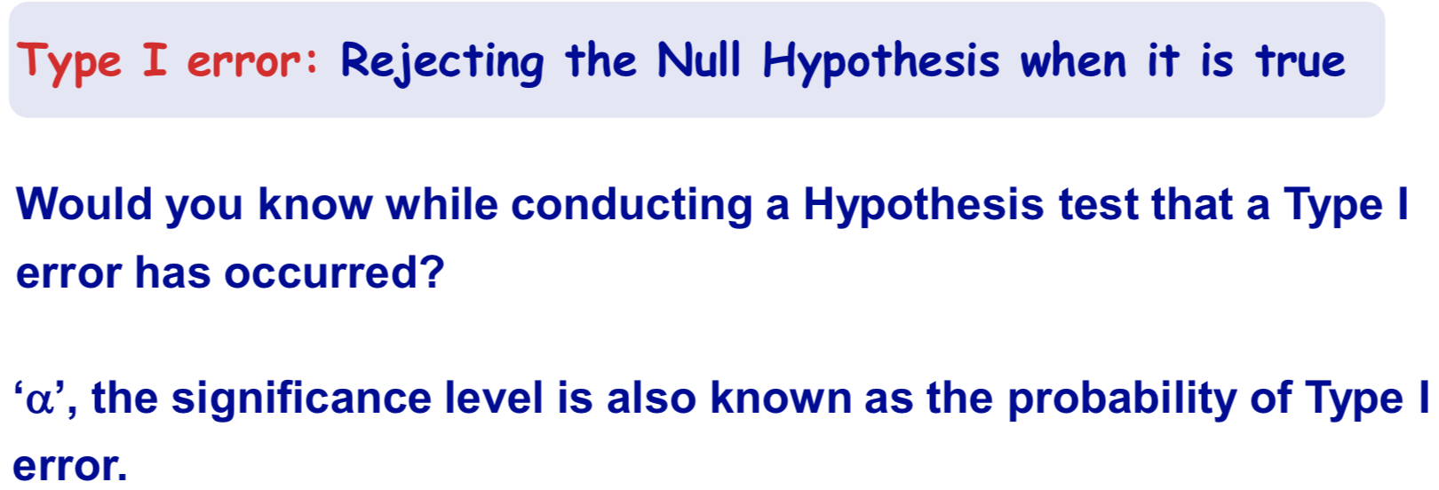
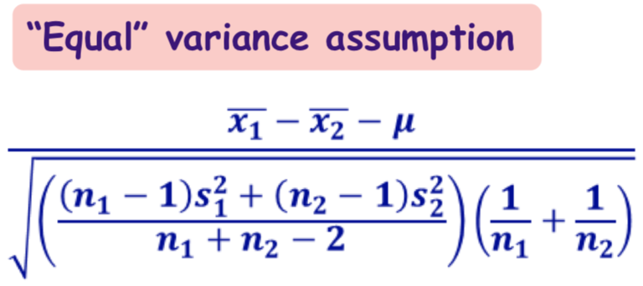
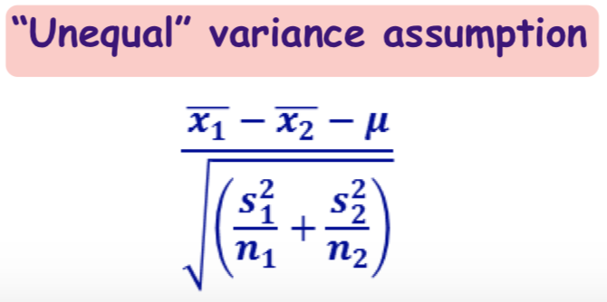
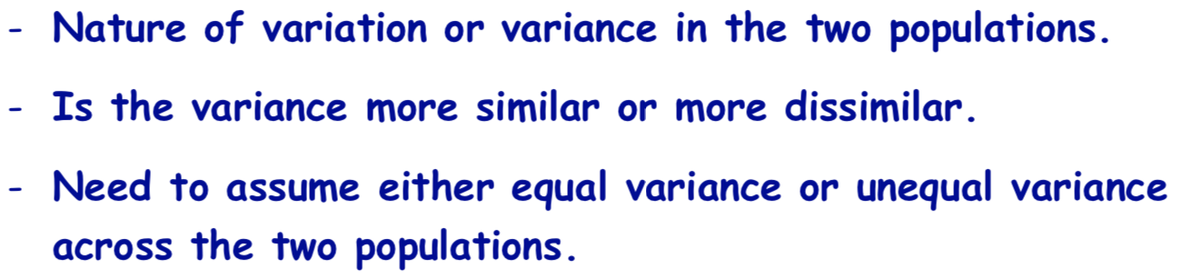

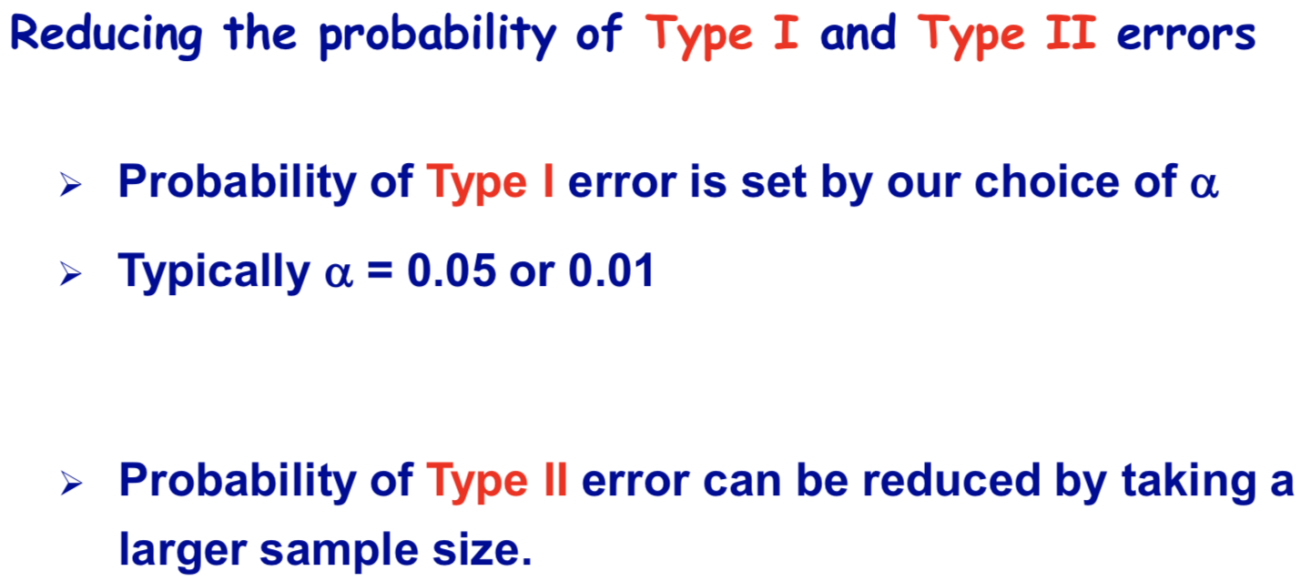


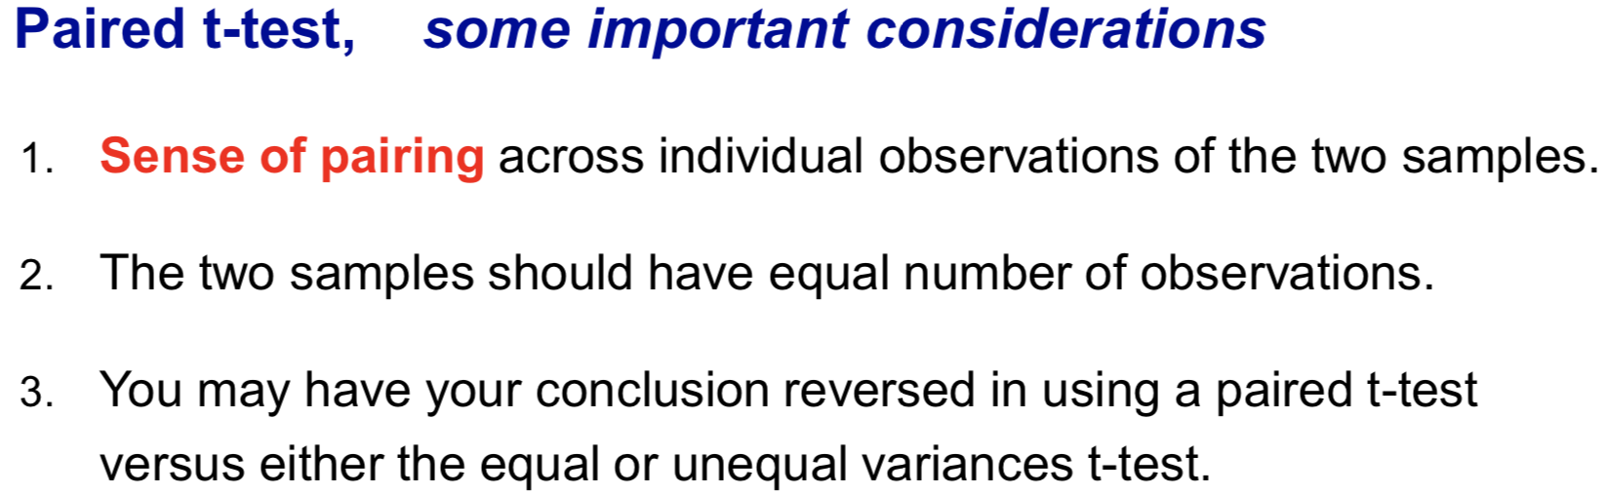
Course 3 Business Applications of Hypothesis Testing and Confidence Interval Estimation
Two population test
Type I and Type II Error
a Difference in Means should be used to compare two populations, not any more than two.
The decision between a paired t-test and an equal or unequal variance t-test is important. The conclusions may be reversed in the two type tests and may give different t-statistics and different t-cutoffs.

Slide 30

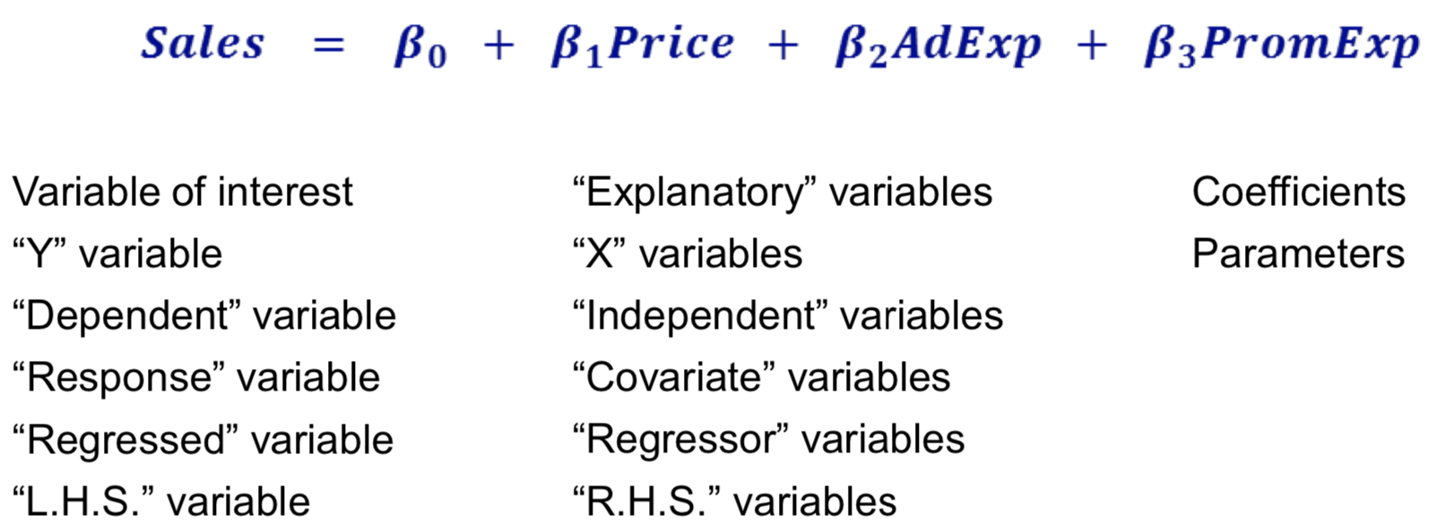

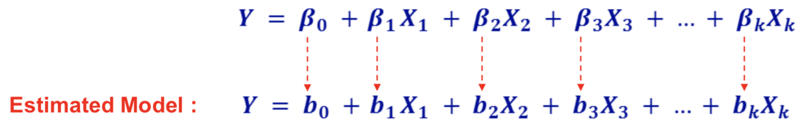

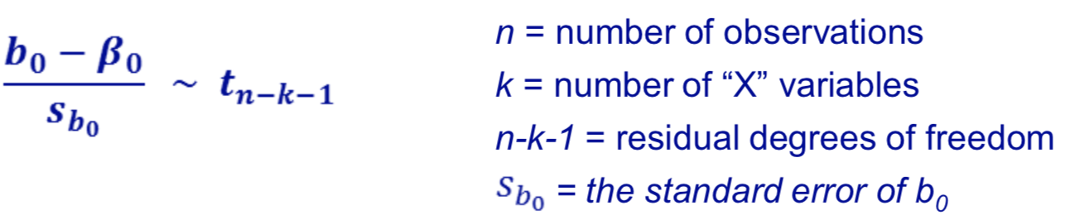
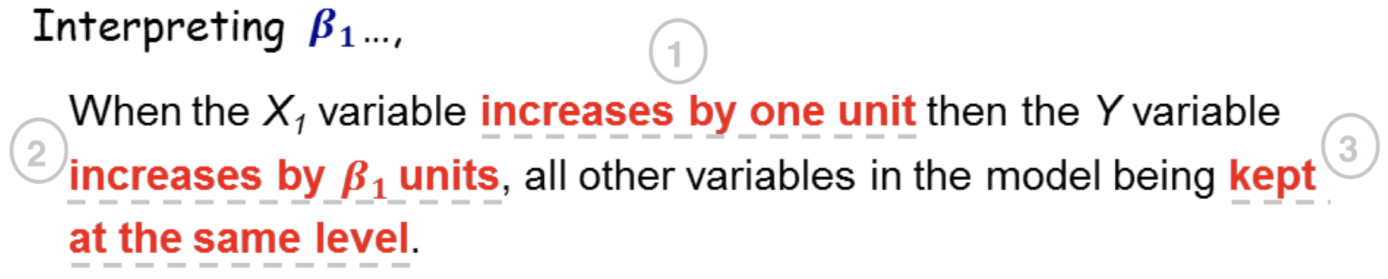
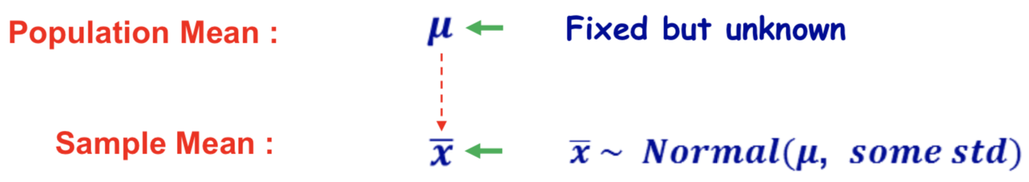
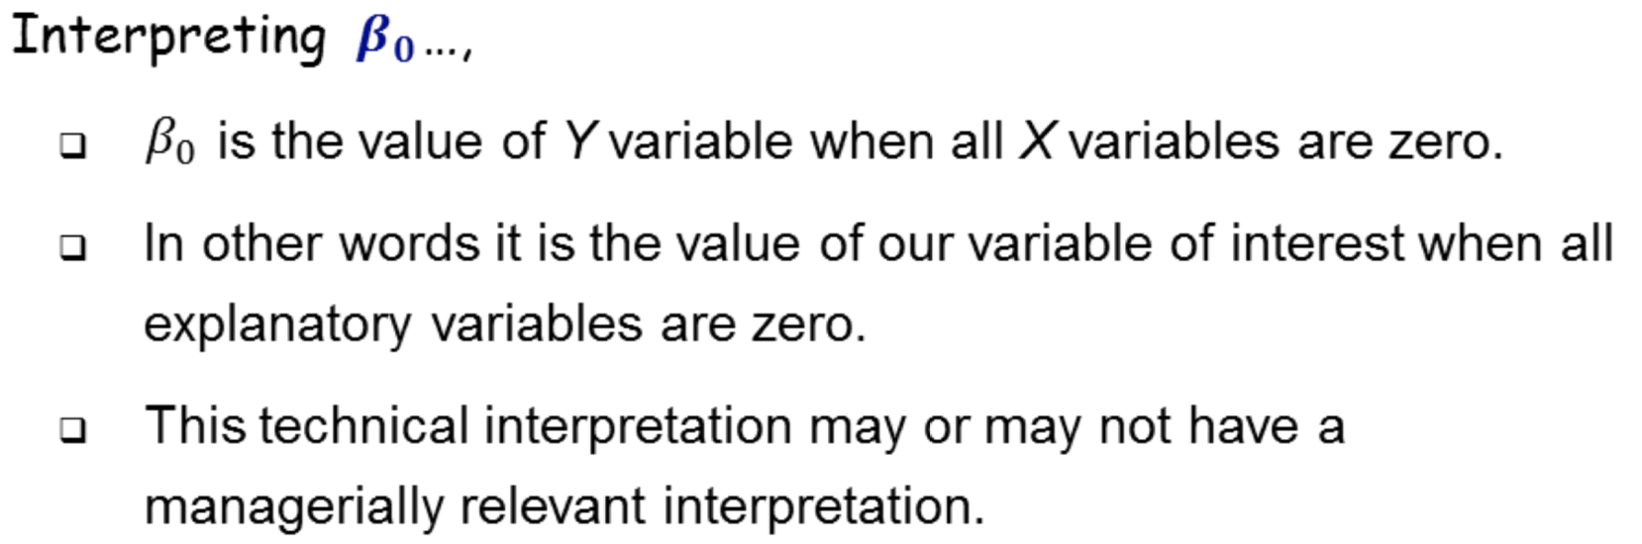
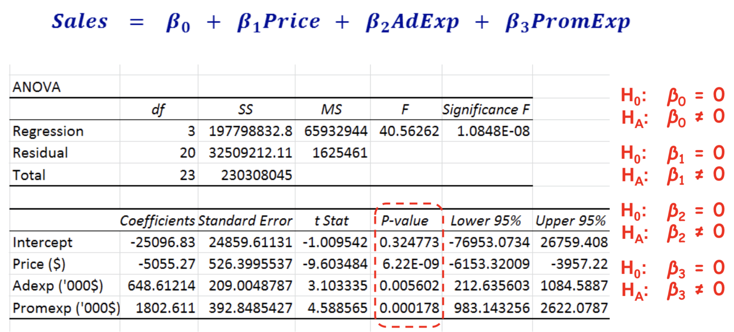
Course 4 Linear Regression for Business Statistics
Linear relationship
Notes:
This does not make managerial sense since talking about a truck with zero age in this example.
So we will not interpret the intercept.

Slide 31

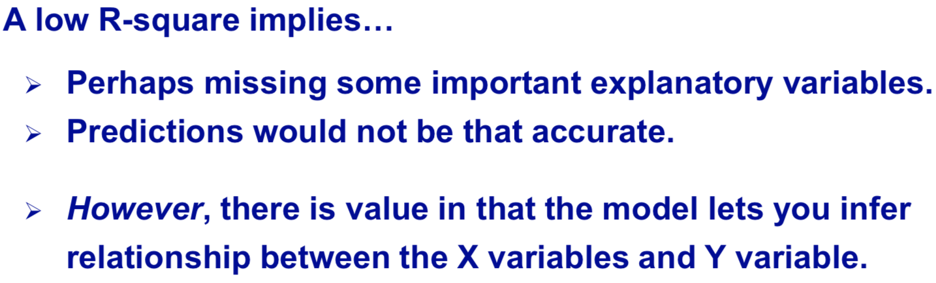
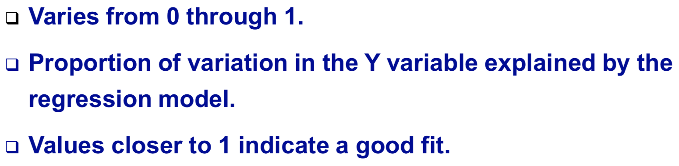

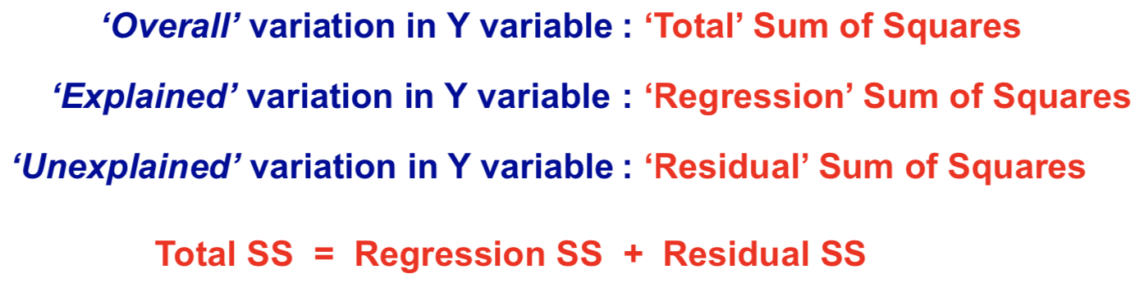
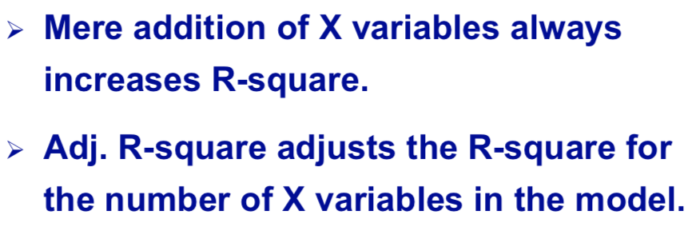
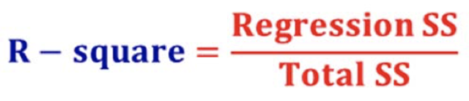
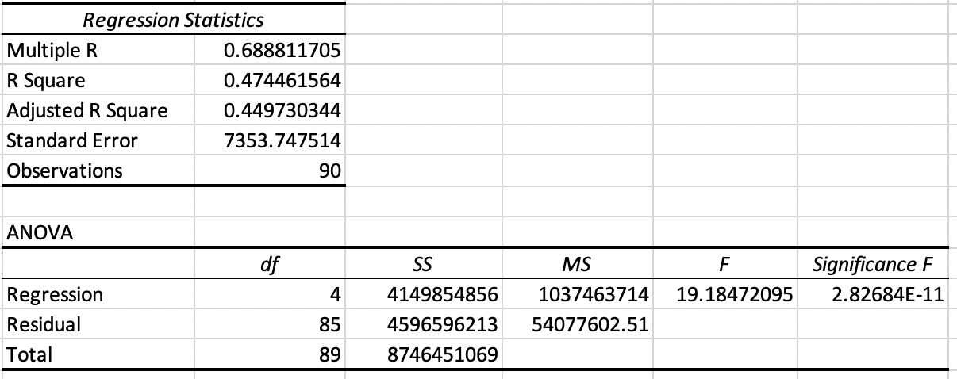
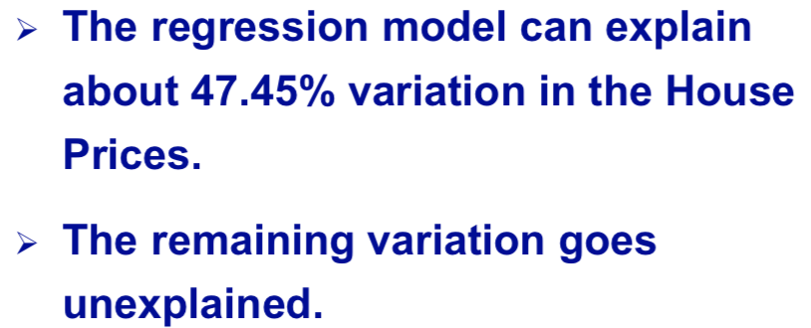
Course 4 Linear Regression for Business Statistics
R-square
R² increases as adding a new predictor
Never decrease
Adjusted R-square
Adjusted R² increases only if the new predictor improves the model
Can be decrease
When explanatory variables are added to a regression, the R-square value always increases whereas the adjusted R-square value sometime increases.

Slide 32
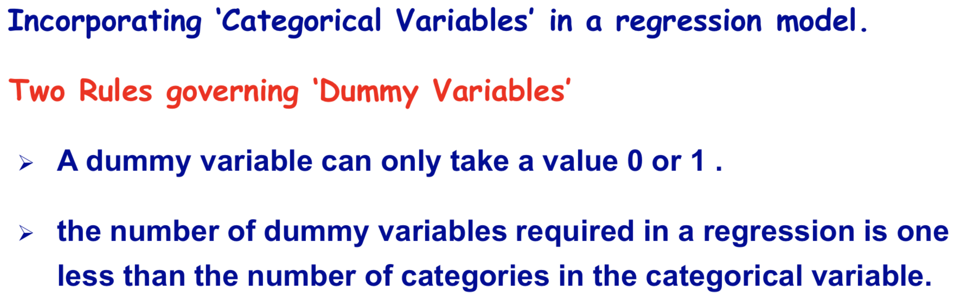
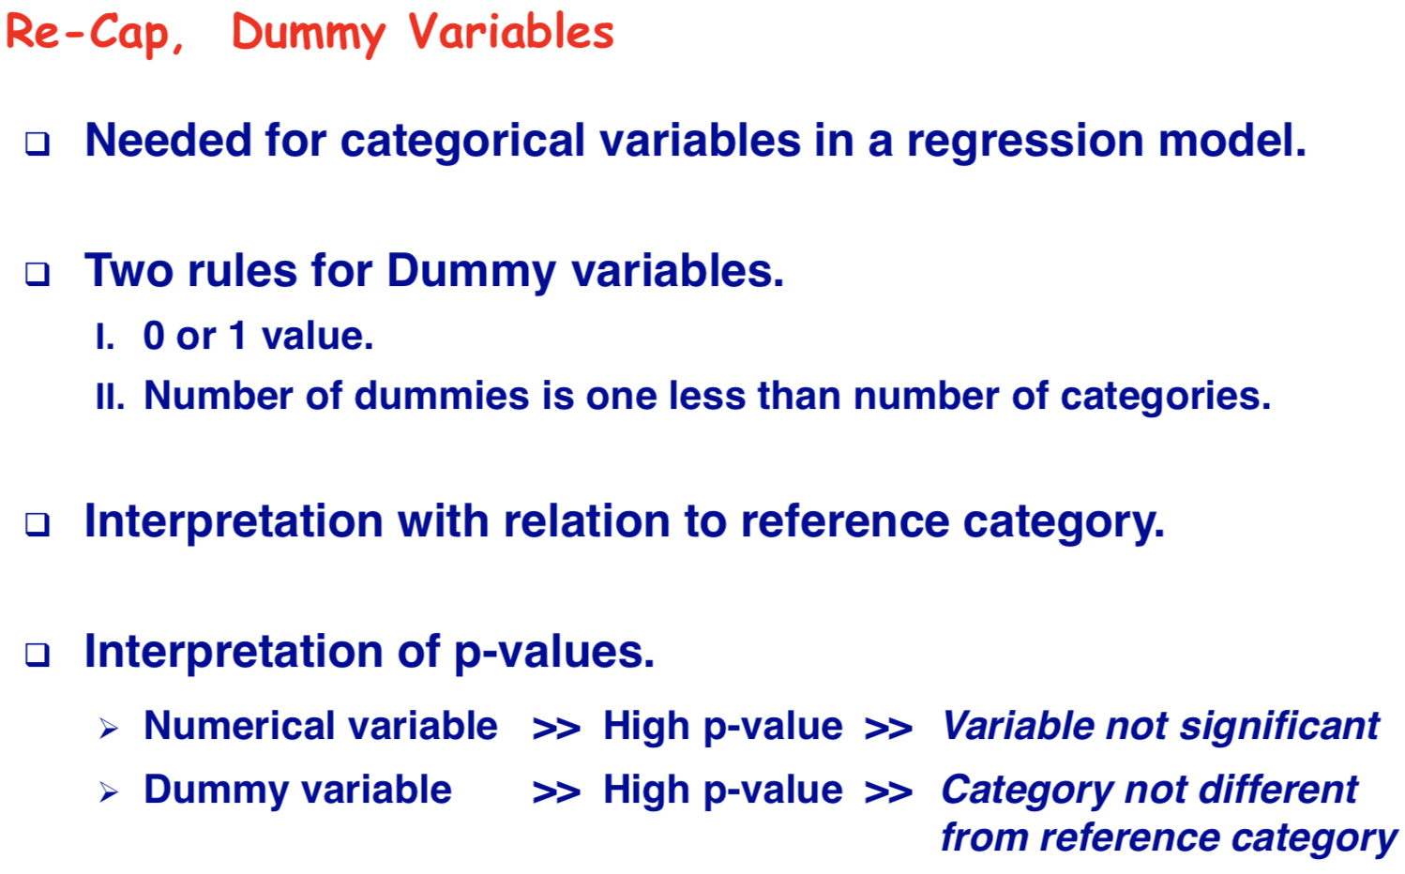
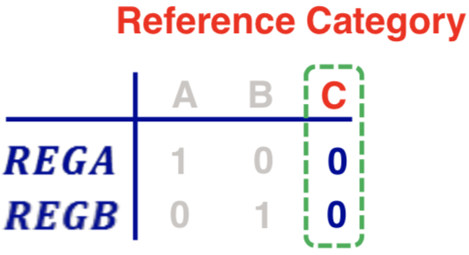
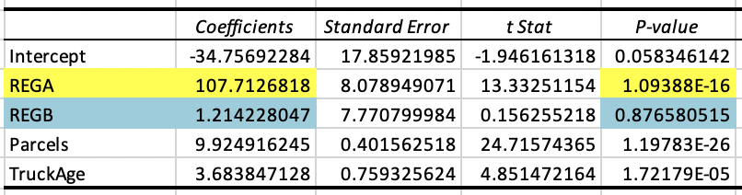
Course 4 Linear Regression for Business Statistics
The coefficients of dummy variables are to be interpreted with a reference to the base category.
The coefficient of REGB is interpreted as the difference in overall delivery time it takes to make deliveries to Region B as compared to Region C
Deliveries made to region A take 107.7 minutes more as compared to deliveries made to region C when all of the variables remaining at the same level.
P value for REGB is greater than 0.05. There's no significant difference between the times to deliver between region B and region C.
Notes:
The coefficients of dummy variables are to be interpreted with a reference to the base category.
Region has two categories, region A and region B. Region B becomes as my base category, because it has been coded as 0. So the interpretation of the coefficient on REGA would be with a reference to region B.
So the interpretation is that, when deliveries are made to region A it takes 106.84 minutes more to deliver as compared to deliveries made to region B, all other variables remaining at the same level.

Slide 33
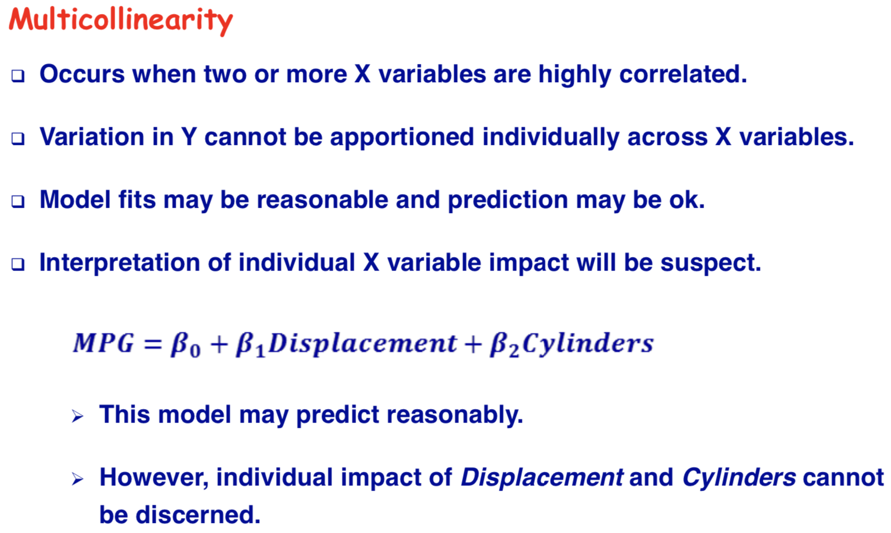
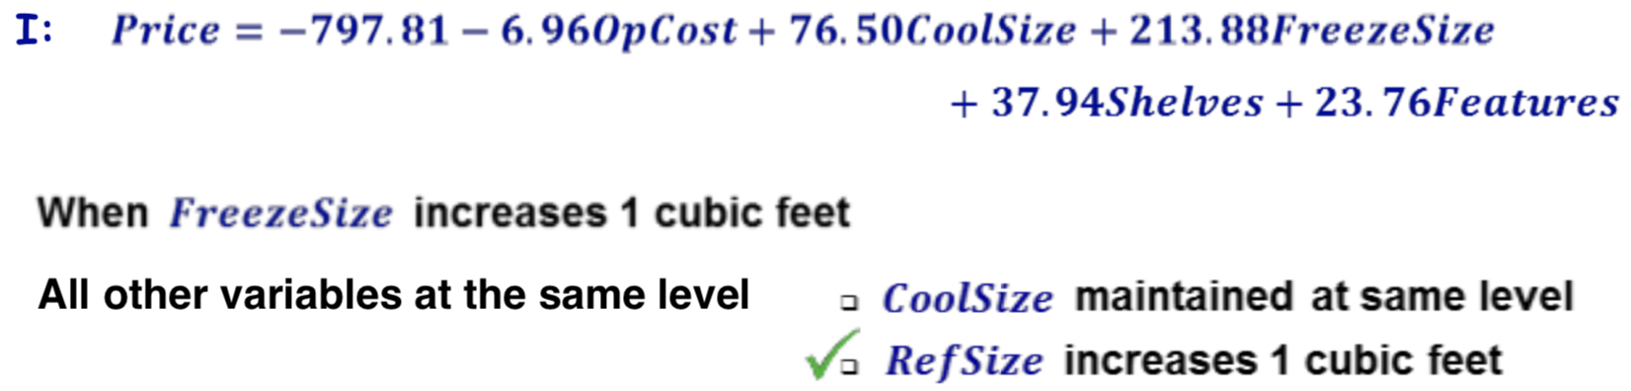


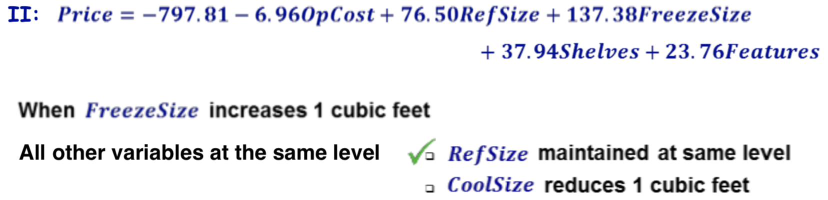




Course 4 Linear Regression for Business Statistics
Multicollinearity in Regression Models

Slide 34




Course 4 Linear Regression for Business Statistics
It makes the intercept to be interpreted more meaningfully.
confidence interval for prediction
Interaction variable allow you to study the impact of one variable at different levels of another variable.
Useful anytime you wish to study the impact of one explanatory variable at different levels of some other variable.
Interaction variables are created by multiplying the variables.
The interacting variables need not be one dummy and the other numerical. They both could be numerical variables.

Slide 35


Course 4 Linear Regression for Business Statistics
Linear regression can help you to discover useful relationships between various business metrics.
Main reasons for taking a natural log transformation.
Natural logs may be taken for reasons other than improving R²
Improve Linearity.
Have ‘Betas’ be interpreted as Elasticities or Growth Rates.

Slide 36
Business Statistics and Analysis Capstone
‘Missing’ or ‘Suspect’ data
Many housing units may have a negative or very low ‘Current Market Value’(VALUE).
For our analysis we will delete all housing units which have a market value of less than $1,000.
Summarize the data for the VALUE and STATUS variables
Basic descriptive statistics
Graphical summary
Test for differences in the variable VALUE between ‘occupied’ and ‘vacant’ housing units.
Do the above analysis separately for all five years, 2005 through 2013.
Prepare a brief summary report, which includes the above categories.

Slide 37
Excel VBA
Studying Note

Slide 38

Copy columns to new sheet with VBA
developer ➮ Visual Basic ➮ Click current workbook ➮ Insert ➮ Module
Sub copycolumns()
Dim lastrow As Long, erow As Long
lastrow = Sheet1.Cells(Rows.Count, 1).End(xlUp).Row
For i = 2 To lastrow
erow = Sheet2.Cells(Rows.Count, 1).End(xlUp).Offset(1, 0).Row
Sheet1.Cells(i, 2).Copy
Sheet1.Paste Destination:=Worksheets("Sheet2").Cells(erow, 1)
Sheet1.Cells(i, 3).Copy
Sheet1.Paste Destination:=Worksheets("Sheet2").Cells(erow, 2)
Sheet1.Cells(i, 5).Copy
Sheet1.Paste Destination:=Worksheets("Sheet2").Cells(erow, 3)
Next i
Application.CutCopyMode = False
Sheet2.Columns.AutoFit
Range("A1").Select
End Sub
Note：Create the module in your present working excel workbook.

